Slide 1
E-commerce Project
Day 6: User Validity Checking

Slide 2

Introduction
This presentation focuses on user validity checking in e-commerce projects, emphasizing techniques and methods to ensure robust user validation.

Slide 3
01
User Validation

Slide 4
Importance of User Validation
User validation is crucial in e-commerce to protect user data, ensure security, and enhance user experience. It helps prevent fraud, builds trust, and improves the overall efficiency of online transactions. Validating users ensures that only legitimate users can access features, thereby reducing the risk of breaches and financial loss.

Slide 5

Common Validation Methods
Common methods for user validation include email verification, phone number authentication, and CAPTCHA to differentiate between human users and bots. Additionally, using strong password policies and multi-factor authentication further enhance security. Each method has its unique advantages and trade-offs, and it's essential to choose the right combination depending on the risk profile of the e-commerce project.

Slide 6
Implementing Validation in E-commerce
Implementing user validation in e-commerce involves integrating various methods such as email confirmation, SMS verification, and advanced algorithms to detect anomalies during login attempts. It's essential to design a seamless signup process that emphasizes validation without being intrusive. Regularly updating these security measures is also critical to safeguard against evolving threats while maintaining user convenience. Additionally, employing techniques like real-time validation during the registration process can significantly enhance user experience and security.

Slide 7
02
Error Handling

Slide 8
Types of Errors in User Validation
Errors in user validation can occur due to incorrect user inputs, such as invalid email formats, password mismatches, or the failure to complete mandatory fields. Additionally, server-side issues like timeouts, and backend errors can also impede the validation process. Understanding these error types helps to design effective solutions to address user frustrations and improve overall satisfaction. It’s vital to categorize these errors to streamline troubleshooting and response strategies.

Slide 9
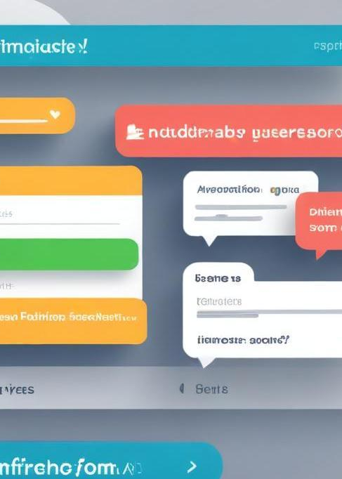
User Feedback Mechanisms
Incorporating user feedback mechanisms is essential for improving the validation process. This includes providing users with clear messages and instructions about validation failures, as well as offering real-time feedback during input. Implementing techniques such as tooltips, inline validation messages, and follow-up emails after failed attempts can guide users and minimize frustration. Engaging users for feedback on their experience can also inform further improvements in the validation process.

Slide 10
Improving User Experience Through Error Handling
To enhance user experience through effective error handling, it is crucial to adopt a user-centric approach. This can involve creating helpful error pages that guide users back to the main functionalities, ensuring the language used is friendly and not overly technical. Additionally, providing options for users to rectify errors easily, such as password reset links and detailed guidance on entering information correctly, contributes to a smoother user journey. Proactive support via chatbots can also reassure users and provide immediate assistance.

Slide 11
Conclusions
User validation and error handling play critical roles in the success of e-commerce projects. Employing robust validation methods can protect sensitive user data, while effective error handling enhances overall user experience. Achieving a balance between security and usability is essential to retain customer trust and satisfaction. Continuous evaluation and adaptation of these processes will ensure that e-commerce platforms can meet the evolving needs of users while safeguarding their information.

